Slide 1

VIKRAM MISRI – INDIA'S NEW DEPUTY NSA!
WAIV – WORLD AN INDIAN VIEW

Slide 2
WAIV – WORLD AN INDIAN VIEW
India’s former ambassador to China, Vikram Misri, appointed as Deputy NSA
Misri also served as private secretory of former Indian PM Manmohan Singh and IK Gujral
Pankaj Saran also coordinated the Modi-Xi meet in Mamallapuram meeting in October 2019

Slide 3

WAIV, WORLD – AN INDIAN VIEW
He also handled Chinese government during 20-month long standoff with China
This Photo by Unknown author is licensed under CC BY.

Slide 4
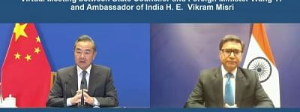
WAIV, WORLD – AN INDIAN VIEW
Chinese Foreign minister Wang Yi had himself thrown farewell to him after he completed him term as India’s ambassador to China

